Slide 2
Objectives
Use nested functions
Create an object literal
Define object properties and methods
Define an object class
Use object constructor functions
Instantiating an object

Slide 3
Objectives (continued)
Define an object prototype
Explore prototype chains
Use the apply() and call() methods
Work with objects and arrays
Create a for…in loop

Slide 4
Working with Nested Functions
Any function, including named functions, can be nested within another function as follows:
function outsideFn() {
commands
function insideFn() {
commands }
commands
}
where
outsideFn() is the outer or containing function

Slide 5
Working with Nested Functions (continued 1)
insideFn() is the inner or nested function
Scope of a nested function is limited to the commands within the containing function
Nested function is hidden from other code in the script, making the code contained and easier to manage

Slide 6
Working with Nested Functions (continued 2)
Example: Nested functions can be used in developing the poker game app for Arthur’s Games website
The app displays the poker table on which users will play a game of draw poker

Slide 7
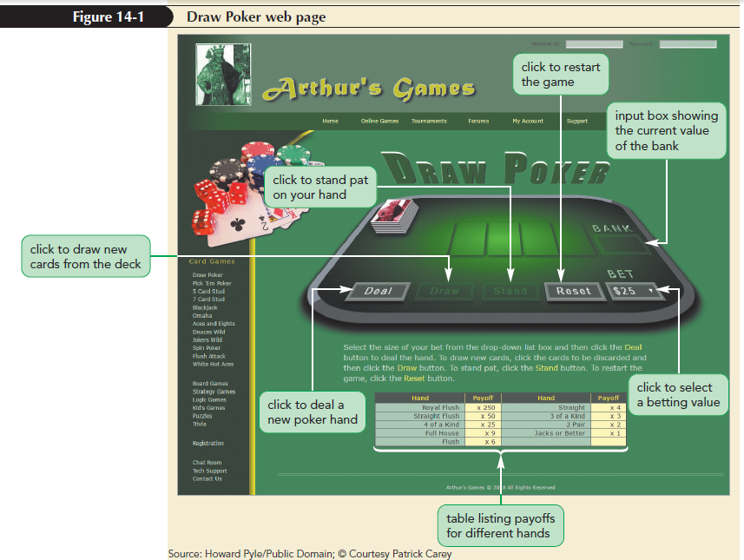
Working with Nested Functions (continued 3)

Slide 8
Working with Nested Functions (continued 4)
All operations for the game will be stored within the playDrawPoker() function
playDrawPoker() function runs automatically when the page loads
playDrawPoker() function is created by adding references to all the buttons on the poker table

Slide 9
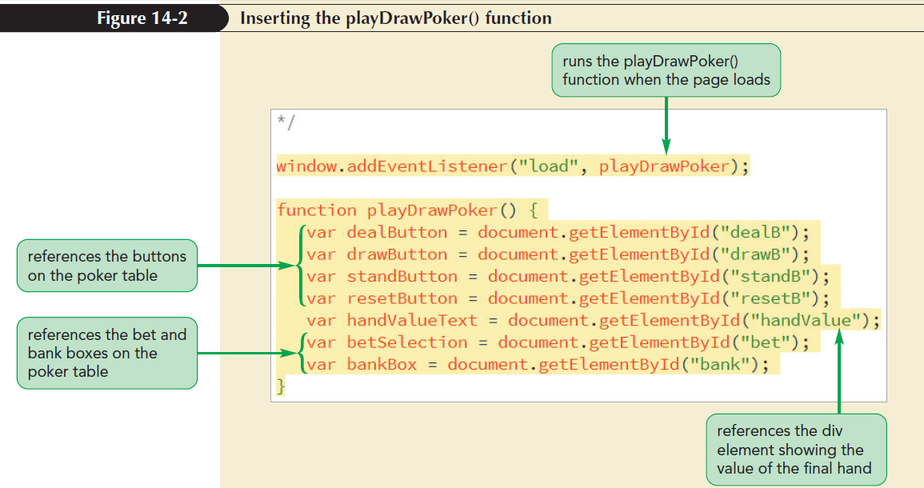
Working with Nested Functions (continued 5)

Slide 10
Working with Nested Functions (continued 6)
Elements on the Draw Poker page perform the following tasks:
Deal button deals five cards from the poker deck into the player’s hand
Draw button replaces all selected cards in the player’s hand with new cards from the deck

Slide 11
Working with Nested Functions (continued 7)
Stand button signals to the dealer that the player wants to keep all the cards in the dealt hand
Reset button restarts the game with a fresh pot, resetting the bank value to $500
Bet selection list places the bet before the next hand is dealt

Slide 12
Working with Nested Functions (continued 8)
The Deal, Draw, and Stand buttons and the Bet selection list will be turned on and off depending on the state of the game
The Draw and Stand buttons are disabled before the deal
The Deal button and Bet selection list are disabled while the current hand is in play

Slide 13
Working with Nested Functions (continued 9)
To disable and enable the buttons, nest the required functions within the playDrawPoker() function
The functions for disabling or enabling the selected object also set the opacity style of the selected object
Disabled objects are semi-transparent on the page

Slide 14
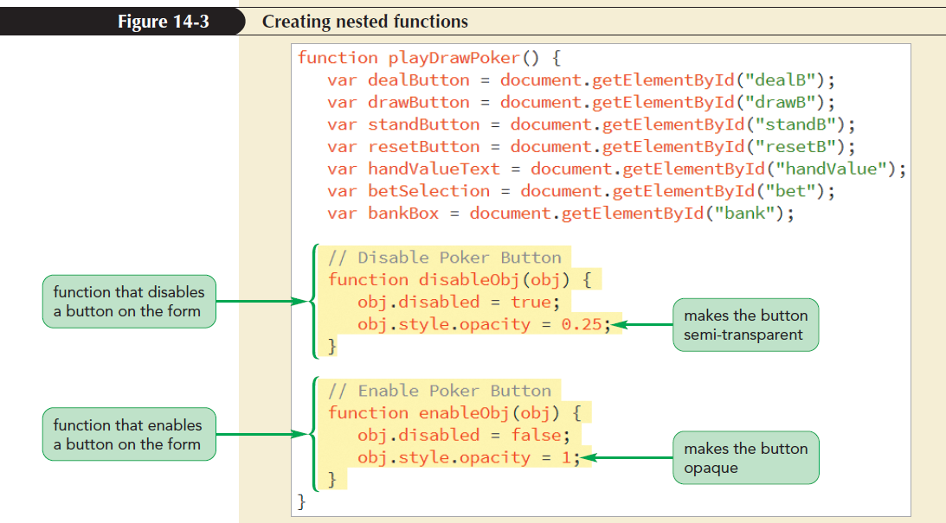
Working with Nested Functions (continued 10)

Slide 15
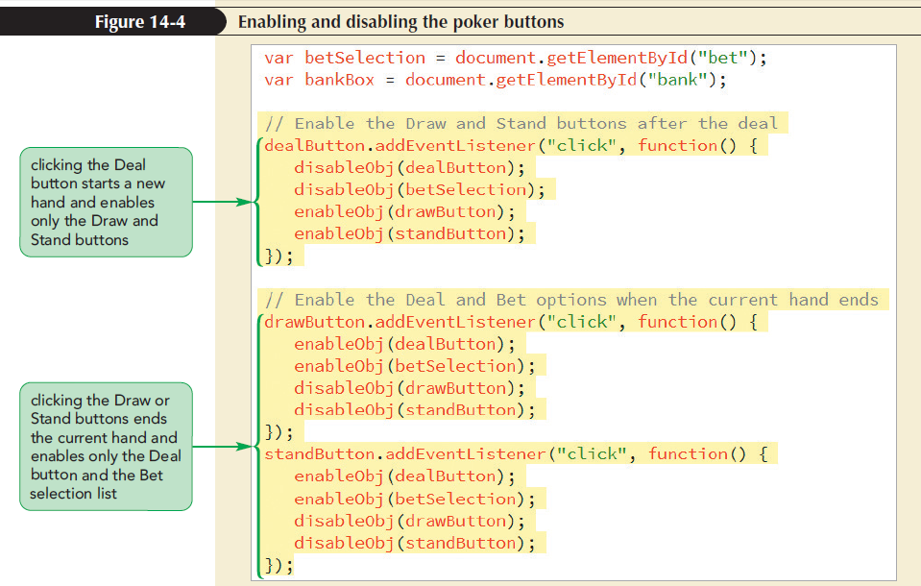
Working with Nested Functions (continued 11)

Slide 16
Introducing Custom Objects
There are three kinds of JavaScript objects
Native objects, such as Date or Array objects, are part of the JavaScript language
Host objects are objects provided by the browser for use in interacting with the web document and browser, such as the window, document, or form objects
Custom objects, also known as user-defined objects, are objects created by the user for specific programming tasks

Slide 17
Introducing Custom Objects (continued 1)
The following custom objects are created for the poker game application:
A poker game object that contains information about the card game being played
A poker deck object that contains information about the cards used in the game
A poker hand object that contains information about the hand played by the user in the game
Poker card objects that contain information about the individual cards in the poker hand

Slide 18
Introducing Custom Objects (continued 2)
A custom object can be defined in one of the following three ways:
Creating it as an object literal
Using an object constructor
Applying the object create() method

Slide 19
Object Literals
The general syntax to create a custom object as an object literal
var objName = {
name1: value1,
name2: value2,
…
};
where
objName is the name of the object

Slide 20
Object Literals (continued 1)
name1, name2, and so on are the names associated with that object
value1, value2, and so on are the values assigned to those names
Each name:value pair contains a property and property value associated with the object

Slide 21
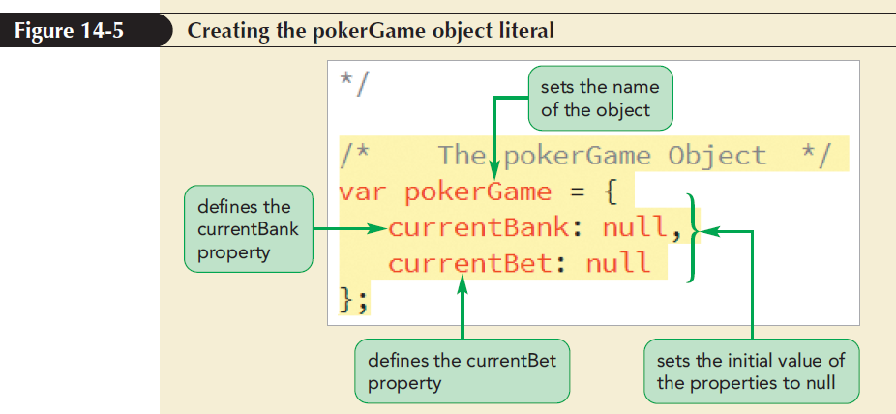
Object Literals (continued 2)

Slide 22
Dot Operators and Bracket Notation
Dot operator: Connects the object name with an object property
object.property
Object properties can also be written using the bracket notation
object[“property”]
where object is the object name and property is the object property

Slide 23
Dot Operators and Bracket Notation (continued 1)
Example: The value of the currentBank property of the pokerGame object could be set with either
pokerGame.currentBank = 500;
or
pokerGame[“currentBank”] = 500;

Slide 24
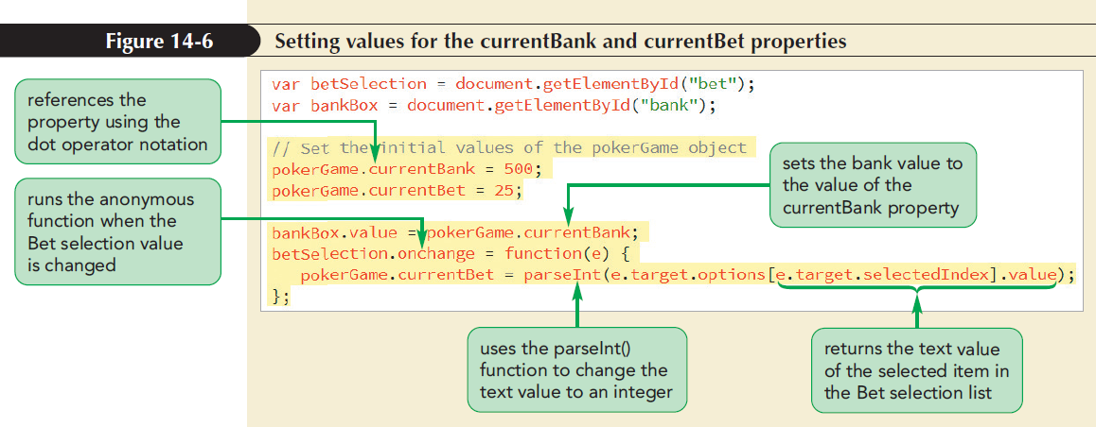
Dot Operators and Bracket Notation (continued 2)

Slide 25
Creating a Custom Method
Methods are added to a custom object by including a function name and its commands as the following name:value pair:
var objName = {
method: function() {
commands
}
}
where method is the name of the method and commands are commands run by the method

Slide 26
Creating a Custom Method (continued 1)
Example: The following code adds the placeBet() method to the pokerDeck object:
var pokerDeck = {
currentBank: null,
currentBet: null,
placeBet: function() {
this.currentBank -= this.currentBet;
return currentBank;
}
}

Slide 27
Creating a Custom Method (continued 2)
The placeBet() method uses the this keyword to reference the current object
The -= assignment operator is used to subtract the value of the current bet from the current bank value
The method concludes by returning the value of the currentBank property

Slide 28
Creating a Custom Method (continued 3)
To apply the placeBet() method to the pokerDeck object, run the following expression:
pokerDeck.placeBet()
Add placeBet() method to the pokerGame object to reduce the bank value by the size of the bet
The placeBet() method should be run whenever the user clicks the Deal button

Slide 29
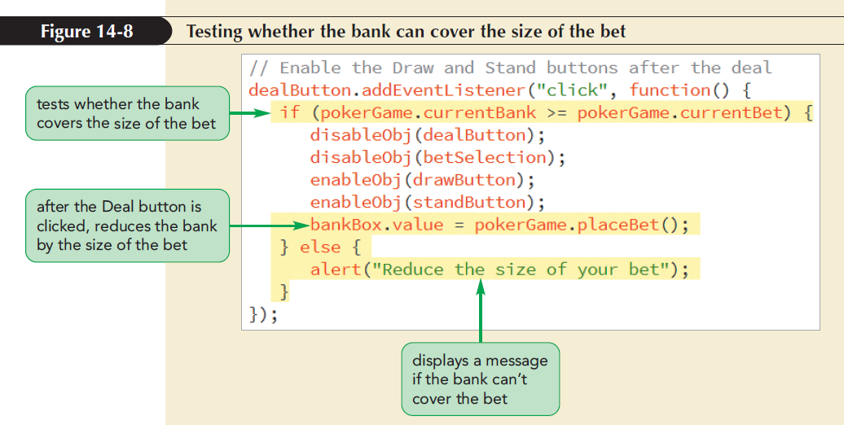
Creating a Custom Method (continued 4)

Slide 30
Creating an Object with the new Operator
Syntax to create a custom object with the new operator
var objName = new Object();
object.property = value;
object.method = function() {
commands
};
where objName is the object name, property is a property defined for that object, and method is a method assigned to that object

Slide 31
Creating an Object with the new Operator (continued)
The new Object() statement is equivalent to an empty object literal {} that creates an object devoid of properties and methods
The biggest limitation of an object created either as an object literal or with the new Object() command is that the object is not reusable

Slide 32
Constructor Functions
Object class can be created using an object constructor or a constructor that defines the properties and methods associated with the object type
Object instance or instance: Specific object that is based on an object class
Creating the object based on an object class is known as instantiating an object

Slide 33
Constructor Functions (continued 1)
Object constructors are defined with the following constructor function:
function objClass(parameters) {
this.prop1 = value1;
this.prop2 = value2;…
this.method1 = function1;
this.method2 = function2;…
}
where
objClass is the name of the object class

Slide 34
Constructor Functions (continued 2)
parameters are the parameters used by the constructor function
prop1, prop2, and so on are the properties associated with that object class
method1, method2, and so on are the methods associated with that object class
this keyword refers to any object instance of the particular object class

Slide 35
Constructor Functions (continued 3)
Instances of an object are created with the following command:
var objInstance = new objClass(parameters);
where
objInstance is a specific instance of the object
objClass is the object class as defined by the constructor function
parameters are the values of any parameters included in the constructor function

Slide 36
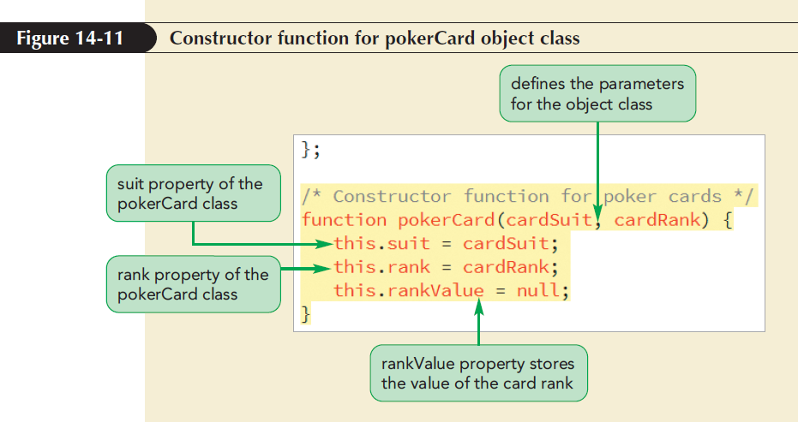
Constructor Functions (continued 4)

Slide 37
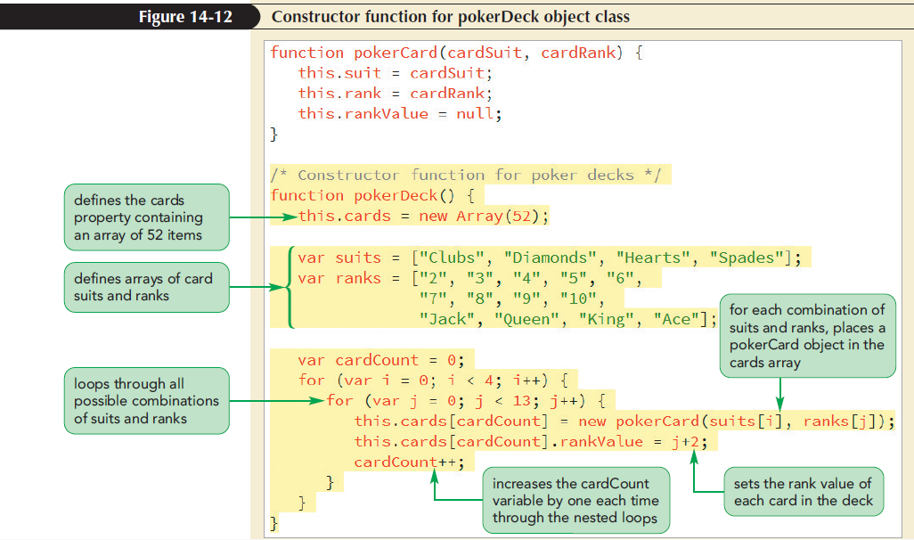
Combining Object Classes
One object class can include objects defined in other classes

Slide 38
Combining Object Classes (continued 1)
To instantiate an object from the pokerDeck class, create a variable named “myDeck” using the following command:
var myDeck = new pokerDeck();
The array of pokerCard objects for the myDeck variable is referenced with the following expression:
myDeck.cards

Slide 39
Combining Object Classes (continued 2)
Each card in the deck can be retrieved by referencing an index in the cards array
Example: The following expression retrieves the fourth card from the deck:
myDeck.cards[4]

Slide 40
Combining Object Classes (continued 3)
All card games require the deck of cards to be randomly sorted
The sort() method of Array objects can be used for random arrangement of the array items
Add the shuffle() method to the pokerDeck object class to randomize the order of items in the cards array

Slide 41
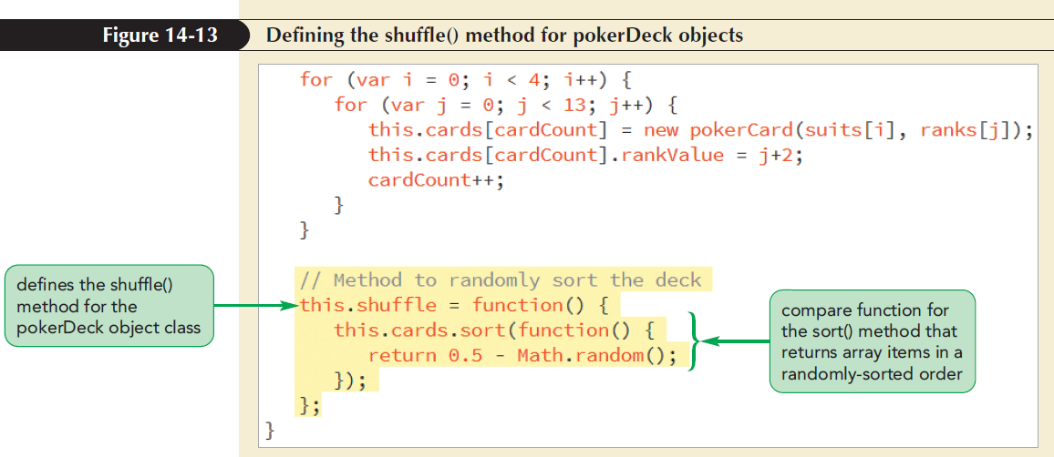
Combining Object Classes (continued 4)

Slide 42
Working with Object Prototypes
Every object has a prototype, which is a template for all the properties and methods associated with the object’s class
When an object is instantiated from a constructor function, it copies the properties and methods from the prototype into the new object

Slide 43
Defining a Prototype Method
The prototype is itself an object and is referenced using the following expression:
objName.prototype
where objName is the name of the object class
Example: The prototype for the pokerCard class of objects is referenced as follows:
pokerCard.prototype

Slide 44
Defining a Prototype Method (continued 1)
Apply the following command to add a method to a prototype:
objName.prototype.method = function;
where method is the name of the method and function is the function applied by the method

Slide 45
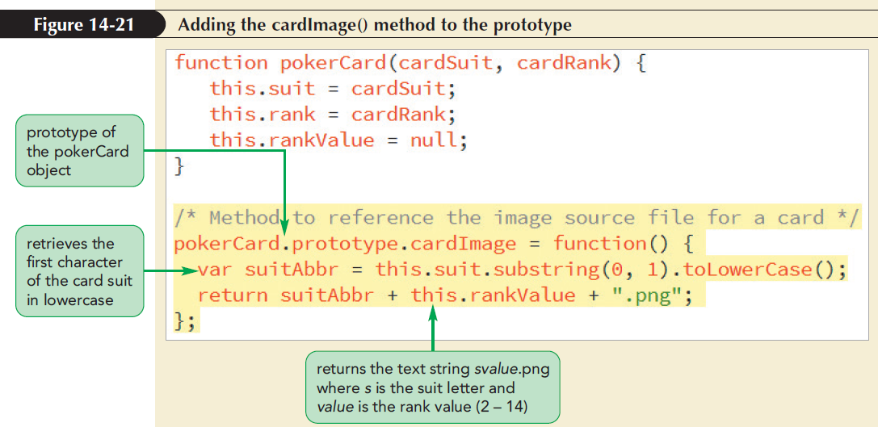
Defining a Prototype Method (continued 2)

Slide 46
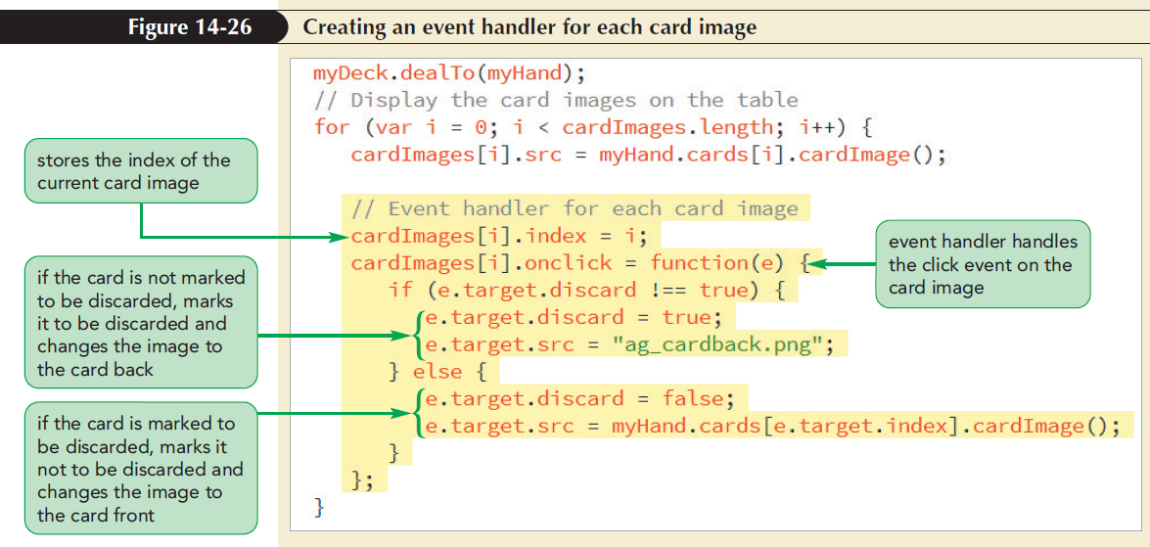
Defining a Prototype Method (continued 3)

Slide 47
Combining Objects
Any object class can inherit the properties and methods from another class using prototypes
The hierarchy of object classes creates a prototype chain ranging from superclass to subclasses
Superclass: Base object class in a prototype chain
Subclasses: Lower classes in a prototype chain

Slide 48
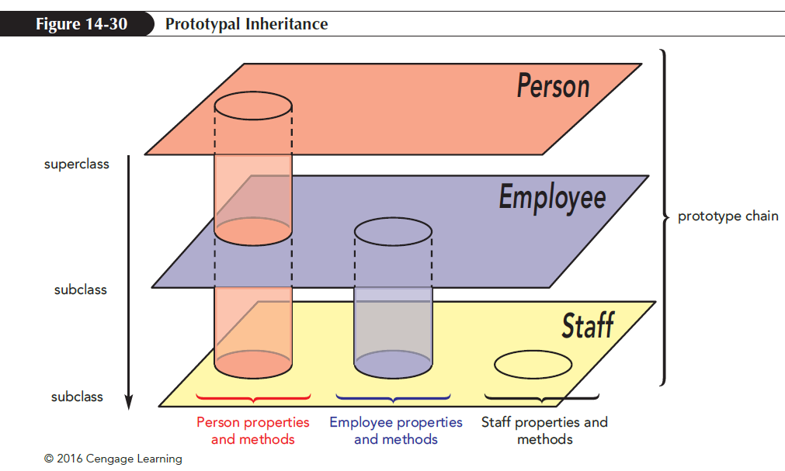
Combining Objects (continued)
Prototypal inheritance: Process by which the properties and methods of superclasses are shared with the subclasses

Slide 49
Creating a Prototype Chain
A prototype chain is created by defining an object prototype as an instance of an object class
Order of classes is important while defining the prototype chain
Start at the top of the hierarchy, and move down to the lower subclasses

Slide 50
Creating a Prototype Chain (continued 1)
JavaScript resolves the code that references an object property or method in the following order:
Check for the property or method within the current object instance
Check for the property or method with the object’s prototype

Slide 51
Creating a Prototype Chain (continued 2)
If the prototype is an instance of another object, check for the property or method in that object
Continue moving down the chain until the property or method is located or the end of the chain is reached
All prototype chains ultimately find their source in the base object

Slide 52
The Base Object
Base object or Object: Fundamental JavaScript object whose methods are available to all objects
A subclass of the base object is created when a custom object is created using an object literal or by applying the new Object() command

Slide 53
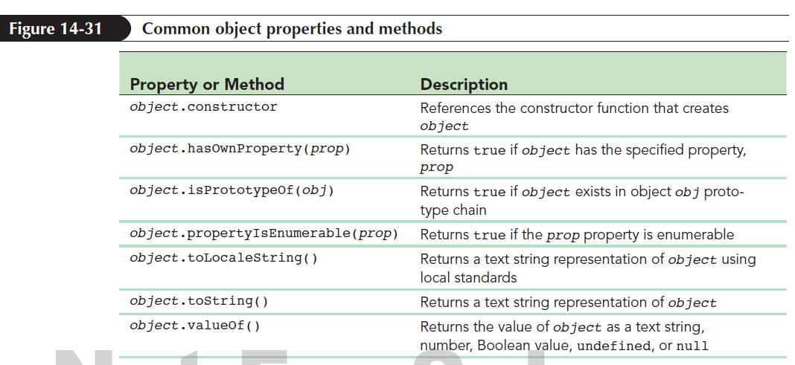
The Base Object (continued 1)

Slide 54
The Base Object (continued 2)
Example: To determine whether an object supports a particular property use the hasOwnProperty() method as follows:
pokerCard.hasOwnProperty(“rank”);
The code returns true if the pokerCard object supports the rank property

Slide 55
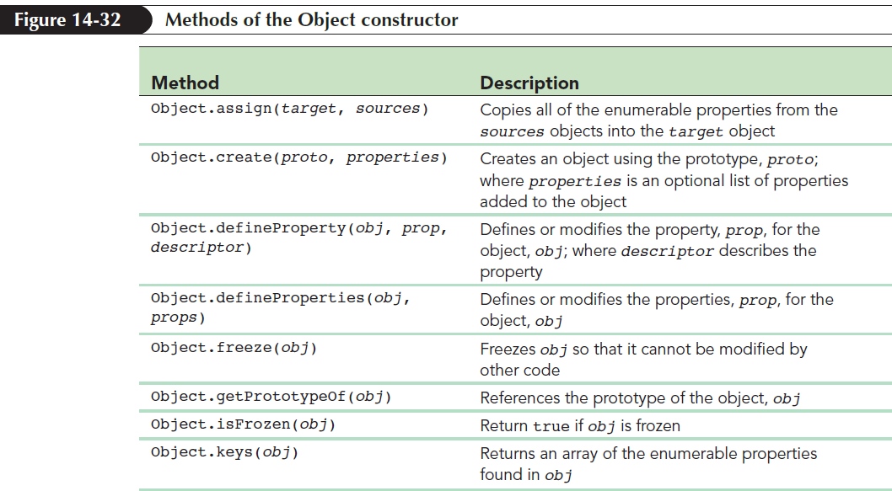
The Base Object (continued 3)
The constructor for Object also supports methods that can be used to retrieve and define properties for any object

Slide 56
Using the apply() and call() Methods
Apply or call a method from one object for use in another object in order to share methods between objects
Borrow a method from one object class using the following apply() method:
function.apply(thisObj [,argArray])

Slide 57
Using the apply() and call() Methods (continued 1)
where
function is a reference to a function
thisObj is the object that receives the actions of the function
argArray is an optional array of argument values sent to the function

Slide 58
Using the apply() and call() Methods (continued 2)
The call() method is similar to the apply() method except that the argument values are placed in a comma-separated list of values instead of an array
The syntax of the call() method
function.call(thisObj, arg1, arg2, arg3, ...)
where arg1, arg2, arg3, and so on is the comma-separated list of argument values for
function

Slide 59
Combining Objects and Arrays
A custom object contains data stored in arrays
JavaScript’s built-in Array object methods speed up the efficiency of a code by looping through the contents of an array

Slide 60
Applying the every() Array method
Use the every() method to test whether every item in an array matches a specified condition
Example: Use every() method to test whether every card in the cards array of the pokerHand object has the same value for the suit property

Slide 61
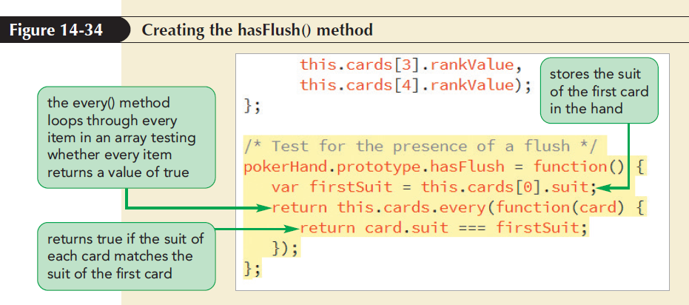
Applying the every() Array method (continued)

Slide 62
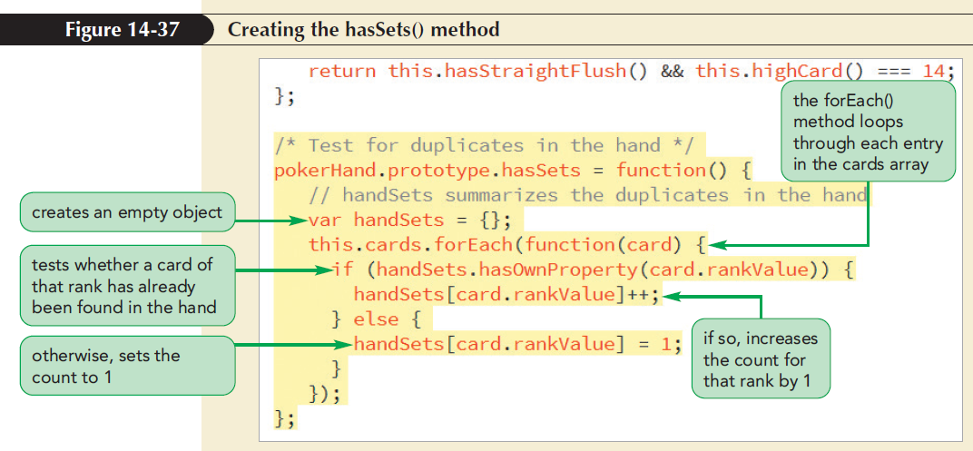
Creating an Object Literal with the forEach() Method
forEach() method is used to run a command block for each item in an array

Slide 63
Applying a for…in loop
for…in loop is used to examine the properties and keys of an object as follows:
for (prop in obj) {
commands
}
where prop references the properties contained within the obj object

Slide 64
Applying a for…in loop (continued 1)
Example: Loop through the contents of the following employee object:
var employee = {
name: “Robert Voiklund”,
position: “manager”,
email: “rvoiklund@example.com” };
Solution: Apply the following for … in loop:
for (prop in employee) {
console.info(prop + “ is “ + employee[prop]); }

Slide 65
Applying a for…in loop (continued 2)
for…in loops do not follow a specific order because properties can be listed and read out in any order
Only the properties that are countable or enumerable are accessible to for…in loops

Slide 66
Applying a for…in loop (continued 3)
Determine whether a property is enumerable using the propertyIsEnumerable() method obj.propertyIsEnumerable(prop)
where obj is the object and prop is the property
Use a for…in loop to loop through every property in the object

Slide 67
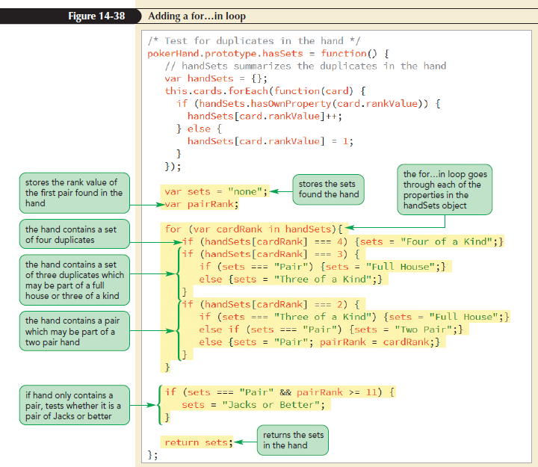
Applying a for…in loop (continued 4)

